Slide 1
Machine Learning for Bank
Python Application Demonstration
Jasmi Patel
Dec 28, 2018
Declaimer – this is my self-learning project and does not use the real data

Slide 2
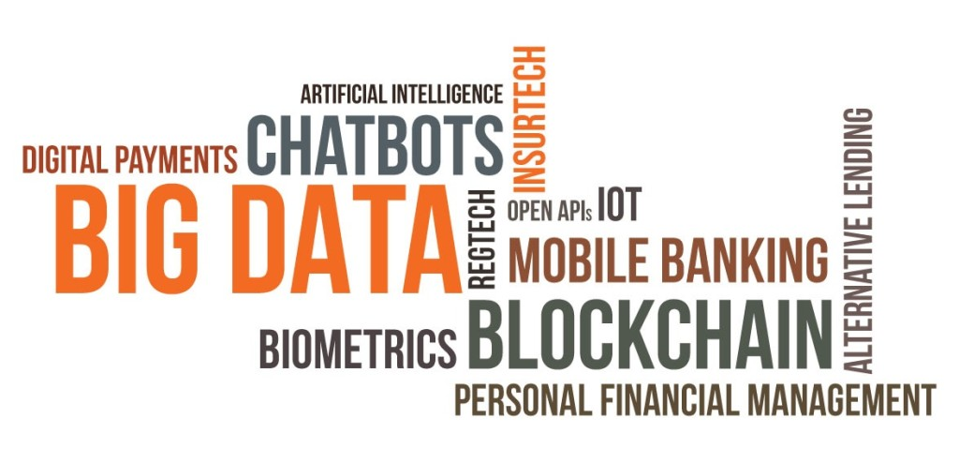
AI for Banks – Use cases
Fraud Detection
Anomaly Detection
Customer Retention
Stock Trends
Economic Forecast
Financial Risk Analysis

Slide 3
Steps for developing ML Application
Identifying Right Use Case
Getting Data and Data Preprocessing – Data Cleaning, Data Wrangling, Identify abnormality and exceptions
Data Exploration
Machine Learning Algorithm Design
Evaluate and Test Output
Experiment with different ML Algorithms
Deploy ML Application
Apply ML Algorithm on new Dataset
Evaluate, Learn and Continuous Improvement

Slide 4

Approach to Machine Learning Algorithms
Source : http://scikit-learn.org

Slide 5
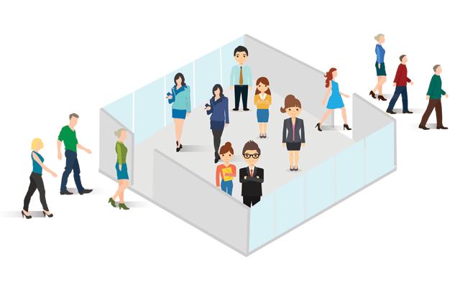
Business Use case for the Demo
Bank Dataset from Kaggle - https://www.kaggle.com/lovelesh/bank-dataset
From given data, identify the Features that have impact on customer Retention or Exit from the Bank
ource - https://www.tellius.com/machine-learning-reduce-customer-churn/

Slide 6
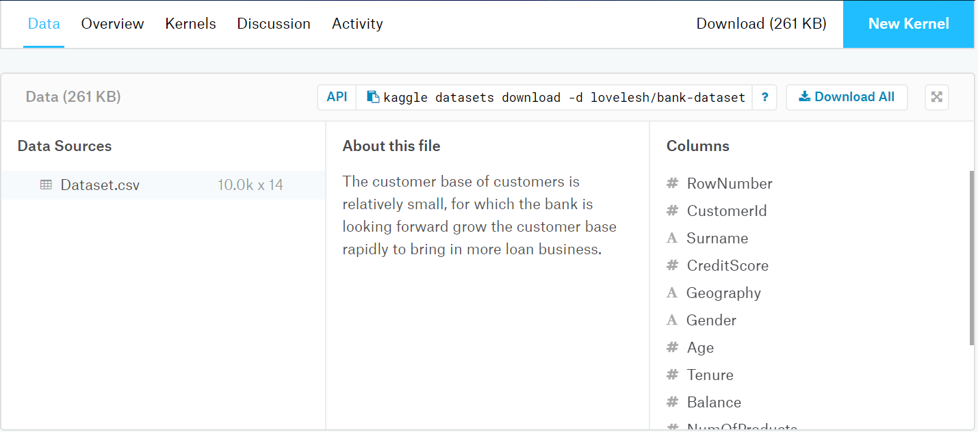
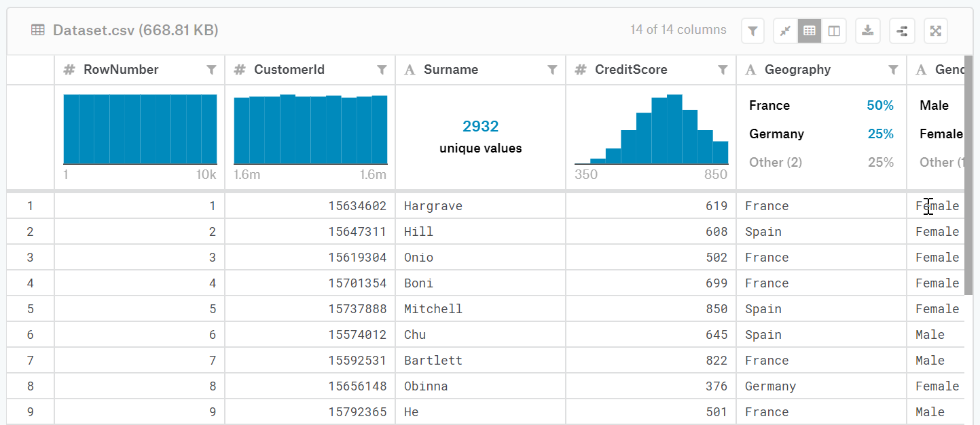
Kaggle Dataset

Slide 7
Machine Learning algorithm
Switch to Jupyter Notebook for demo

Slide 8
Statistical Analysis with Gretl
Demo
CAP Curve

Slide 9
Unsupervised Learning : K-Means Clustering
Using Unsupervised K-Means Clustering Algorithm
1. Extracting Additional Features from given dataset and Normalize Data – so each feature has same weight irrespective of size.
2. Using Elbow method to find optimal Clusters
3. Dividing data points into Clusters of data with similar features
4. Using Distance formula to calculate largest distance from centroids and identifying Anomalies and Outliers
5. Mapping Anomaly data points for Exploratory Analysis

Slide 10
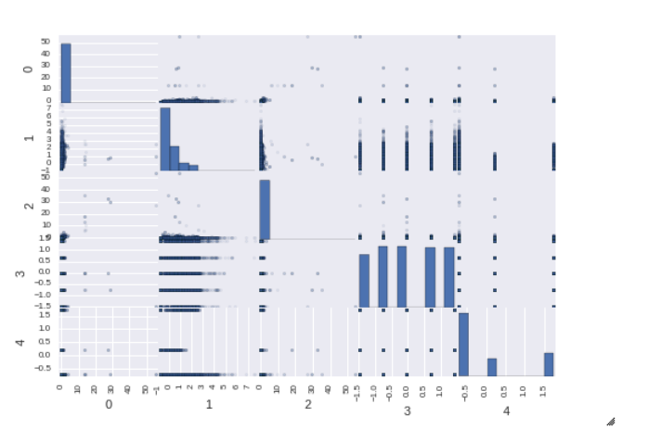
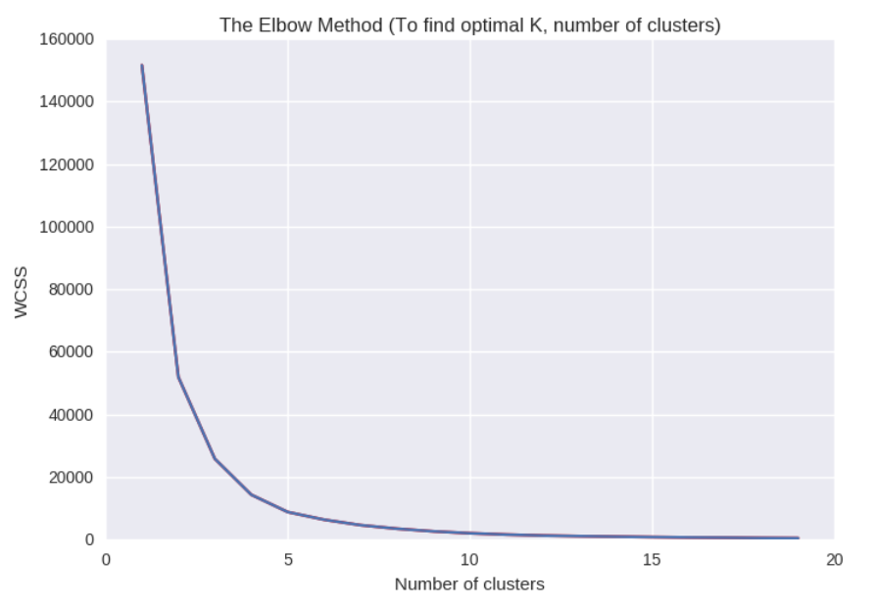
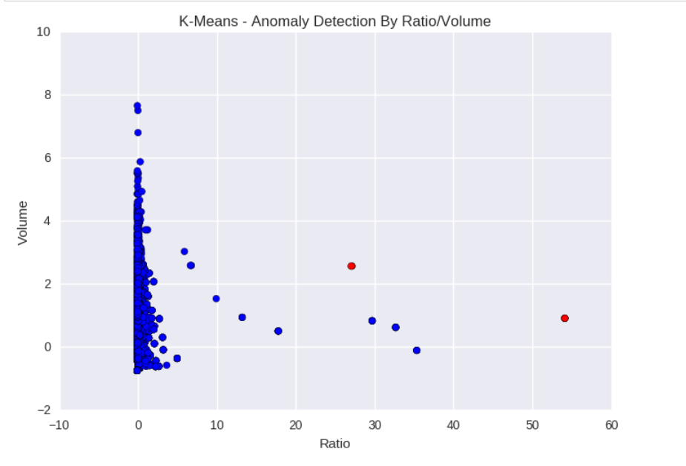
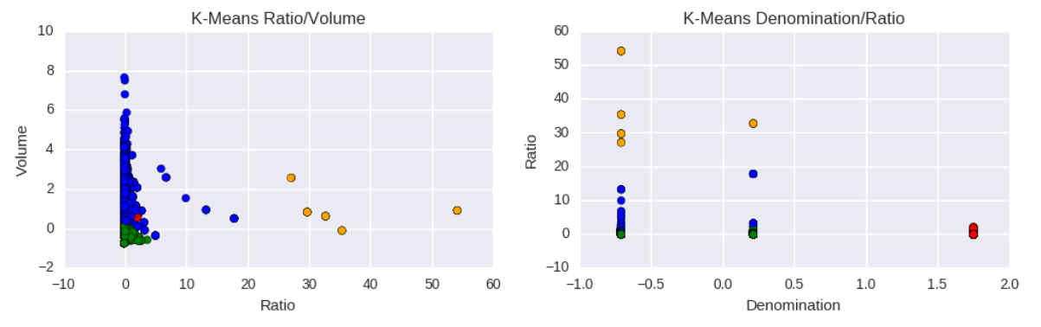
Steps for K-Means Clustering and Anomaly Detection
Feature Matrix
Elbow Method to find Optimal Clusters
Anomaly Detection
K-Means Clustering

Slide 11
AZURE MACHINE LEARNING STUDIO BASED EXPERIMENT
Azure Machine Learning Studio gives you an interactive, visual workspace to easily build, test, and iterate on a predictive analysis model.
Drag-and-drop datasets and analysis modules onto an interactive canvas, connecting them together to form an experiment, which you run in Machine Learning Studio.
To iterate on your model design, you edit the experiment, save a copy if desired, and run it again. When you're ready, you can convert your training experiment to a predictive experiment, and then publish it as a web service so that your model can be accessed by others.
There is no programming required, just visually connecting datasets and modules to construct your predictive analysis model.

Slide 12
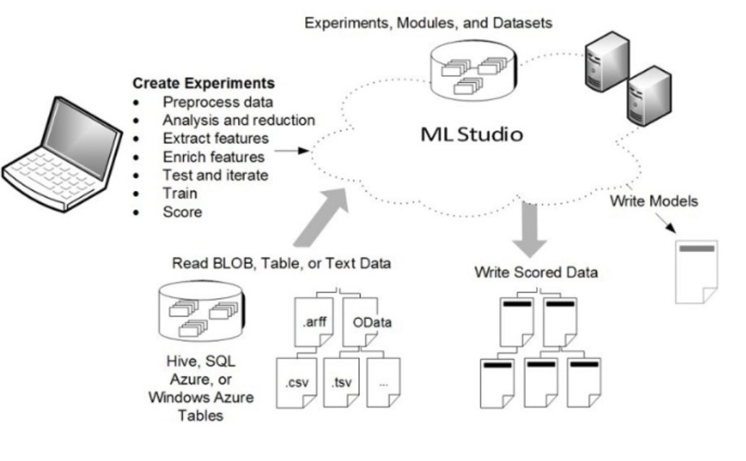
Azure Machine Learning Studio Architecture

Slide 13
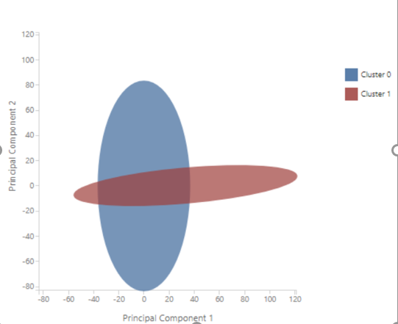
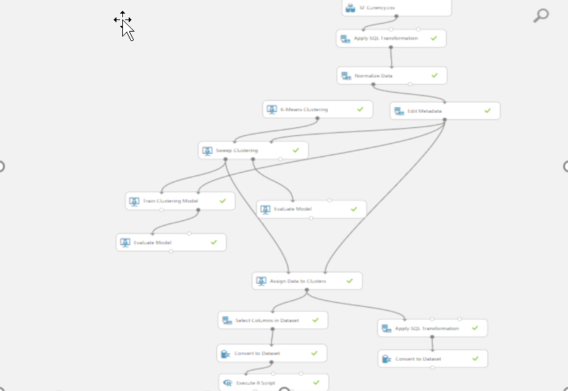
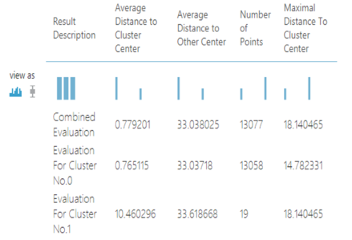
Azure Experiment

Slide 14
Thank You !!

